Slide 1
Creating Domain Specific Languages in F#
PhD student @ University of Cambridge tomas@tomasp.net Tomas Petricek @tomaspetricek Conspirator behind http://fsharp.org

Slide 2
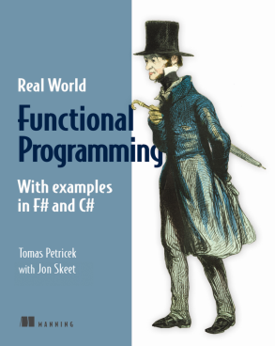
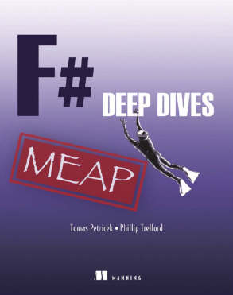
Real World Functional Programming
tutorials F# and C# monads functional concepts practical examples
F# Deep Dives
industry experts . domain modeling financial & insurance web & data actor model concurrency social gaming
F# Trainings & Consulting
testing London async & concurrent New York DSLs data processing http://functional-programming.net

Slide 3
software stacks trainings teaching F# user groups snippets mac and linux cross-platform books and tutorials
F# Software Foundation
F# community open-source MonoDevelop
http://www.fsharp.org
contributions research support consultancy mailing list

Slide 4
Domain-specific languages
We have a class of problems
Create a language for the class
Use language to solve them
DSLs and functional languages
Internal DSLs are just library
External DSLs are easier to build

Slide 5
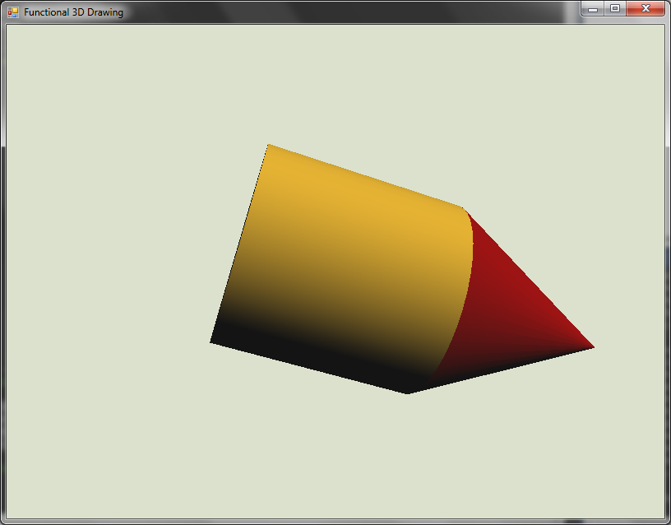
Domain-specific languages
Language for solving specific problems
Contrast with general purpose languages
Fun.cylinder
|> Fun.translate (0, 0, 1)
|> Fun.color Color.Gold $
Fun.cone
|> Fun.color Color.DarkRed

Slide 6
Demo: Building a castle
Domain Specific Language
Defines a few simple primitives
Extensible by composition
Single-purpose or general-purpose?
Most code is single-purpose
Can use general-purpose if needed
See also FAKE: the F# Make

Slide 7
Building a DSL for: Option Pricing

Slide 8
Demo: Modeling Euro options
What is the language?
Primitive values
Composition operations
How do we use the model?
Drawing a pay-off diagram
Calculating option price
Checking for execution

Slide 9
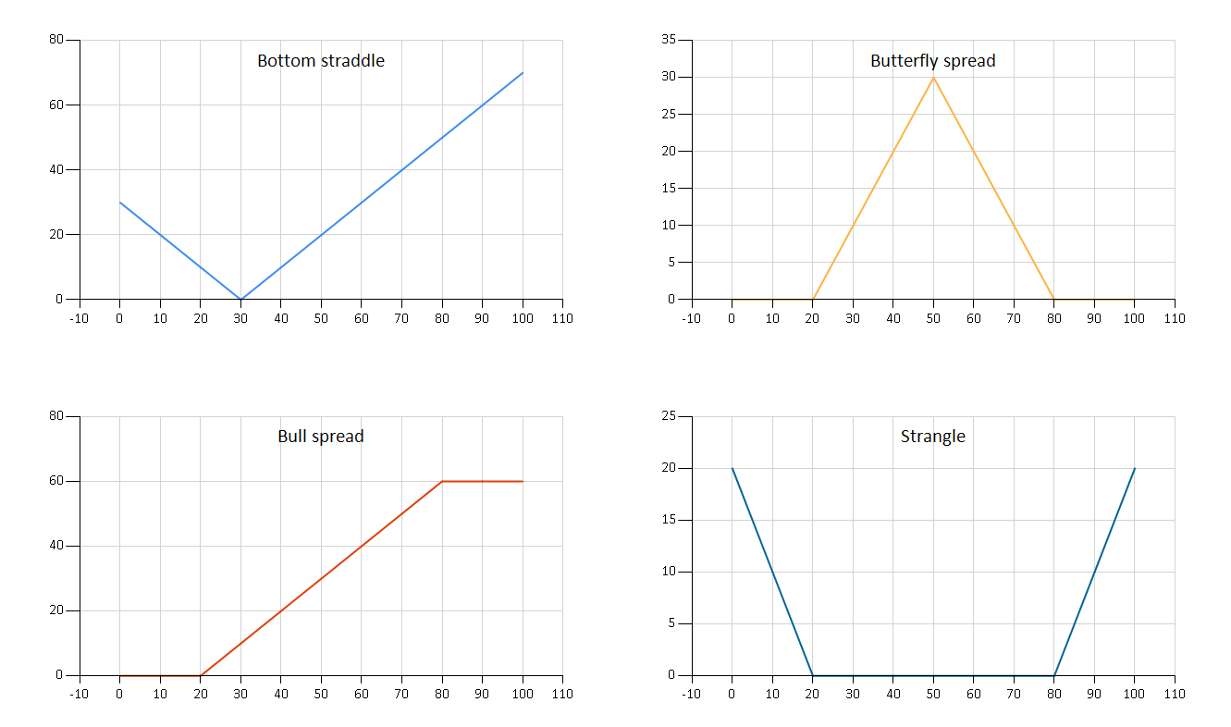
Composed options

Slide 10
Building the model
Primitives of the language
Composition combinators
type OptionKind = Call | Put
type Option =
| European of OptionKind * float
| Combine of Option * Option
| Times of float * Option

Slide 11
Demo: Building & using the DSL
Make it more convenient
Custom operators
Derived primitives
Use it for its purpose
Drawing pay-off diagrams
Evaluating option price

Slide 12
Domain-specific languages
Advantages
Disadvantages
Readability
Greater for External DSL
Maintainability
Hides the implementation
Internals can be changed
Domain Focus
Non-experts can read it
Additional abstraction
Smaller for Internal DSL
Time to implement
Easier for Internal DSL
Time to learn
Avoid crazy operators
Make it familiar
Notes:
Prefer internal DSLs

Slide 13
Internal DSL: Building Blocks
Vanilla .NET
F# Specific
Method chaining
Enumerations
Classes
Operator Overloading
Attributes
Iterators & LINQ
Extension methods
Pipelining
Discriminated Unions
Records
Custom Operators
Quotations
Computation Expressions
Functions

Slide 14
Building a DSL for: Detecting Price Patterns

Slide 15
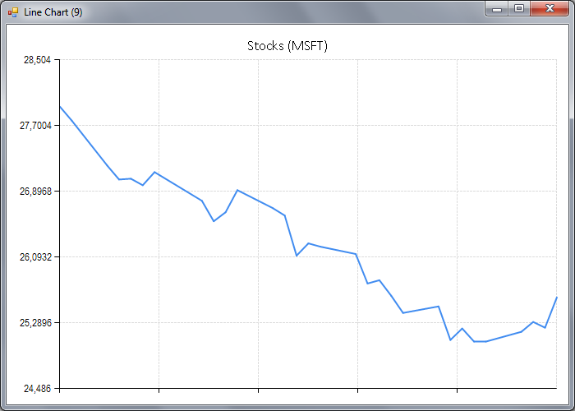
Declining pattern

Slide 16
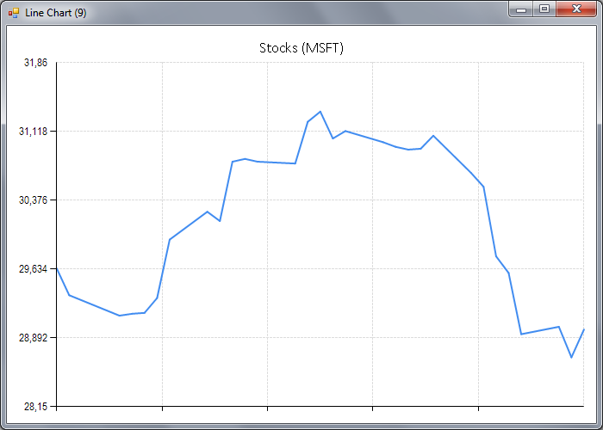
Rounding top pattern

Slide 17
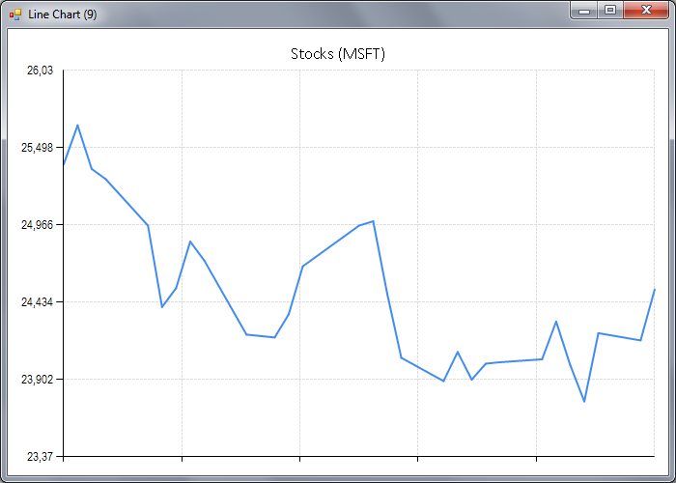
Multiple bottom pattern

Slide 18
Doman-specific language approach
Primitive classifiers
Declining price
Rising price
Combinators for classifiers
Average using regression
Sequence multiple patterns
Check patterns at the same time

Slide 19
Demo: Detecting price patterns
Building complex from simple
Check multiple conditions
Calculate minimum value
All values are in a range
let bothAnd a b =
both a b |> map (fun (a, b) -> a && b)
let minimum =
reduce min |> map (fun v -> Math.Round(v, 2))
let inRange min max =
bothAnd (atLeast min) (atMost max)

Slide 20
How does it work?
What is a classifier?
A function value!
Given data, calculate the result
Generic – can produce any value
Abstract – representation is hidden
type Classifier<'T> =
ClassifyFunc of ((DateTime * float)[] -> 'T)

Slide 21
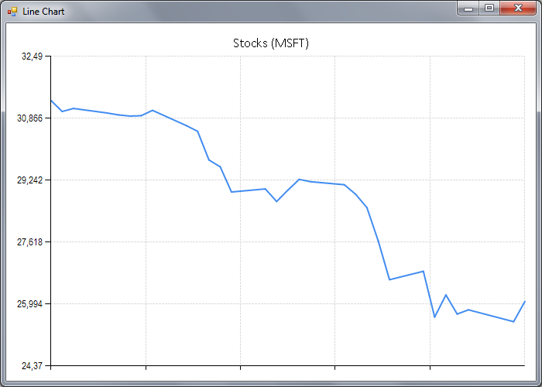
Demo: Detecting more patterns
Double bottom pattern
Change over regression
Down–Up two times
Declining fast pattern
Declining over regression
(Max – Min) > 3 USD

Slide 22
Advanced Techniques for Embedded DSLs

Slide 23
Advanced Embedded DSLs
Computation expressions
Reinterpret expression composition
Add constructs with F# 3.0 queries
Meta-programming with quotations
Reinterpret F# expressions
Active patterns
More expressive pattern language
Implementing external DSLs

Slide 24
Repeating patterns in DSLs
Repeating functions in DSLs
Map: transform the produced value
Bind & return: composition of computations
Simplify using them? With language syntax?
('T -> 'R) -> Clsif<'T> -> Clsif<'R>
('T -> Clsif<'R>) -> Clsif<'T> -> Clsif<'R>
'T -> Clsif<'T>

Slide 25
F# computation expressions
Syntax for computations
For types with certain operations
Aka monads in Haskell
Declining fast pattern
classify {
let! max = P.maximum
let! min = P.minimum
let! upwards = P.regression P.rising
return upwards & (abs (min - max) > 3.0) }

Slide 26
F# query expressions
Customize the meaning of a query
Query for event processing
Custom operators e.g. iter, select, pairwise
Transformations, joins, merging and more
Full power to be explored!
event {
for e in frm.MouseDown do
pairwise into (e1, e2)
select (e1.X - e2.X, e1.Y - e2.Y) into r
iter (printfn "%A" r) }

Slide 27
F# active patterns
Extending the pattern language
Parsing Markdown format
Detecting character patterns
Detecting multi-line patterns
See more at http://manning.com/petricek2
match input with
| Bracketed '*' '*' (body, rest) -> (...)
| Bracketed '[' ']' (body,
Bracketed '(' ')' (link, rest)) -> (...)
| _ -> (...)

Slide 28
Summary

Slide 29
How To: Building your own DSL
❶ Understand Primitives and Combinators
❷ Model the language using Discriminated Unions
❸ Add convenient Syntax

Slide 30
For more information…
Learn and explore F#
Read tutorials at http://tryfsharp.org
Join & help with F# Foundation
Visit http://fsharp.org and for on GitHub!
New York F# Trainings & Tutorials in May
Check out: http://functional-programming.net
Contact me directly: tomas@tomasp.net

